Slide 1


Slide 2


Bringing your Apps to Windows 11 on ARM
Jeremy Sinclair Windows Insider MVP @sinclairinat0r

Slide 3
Agenda
Why Build For Windows on ARM
Windows 11
Windows App SDK
Demo

Slide 4
Why Build For Windows on ARM?
Only Windows platform that can run x86, x64, ARM32 and ARM64 applications
.NET 6 = Complete Arm64 support
WPF, WinForms
Arm64 + x64 coexistence
Native performance improvements

Slide 5
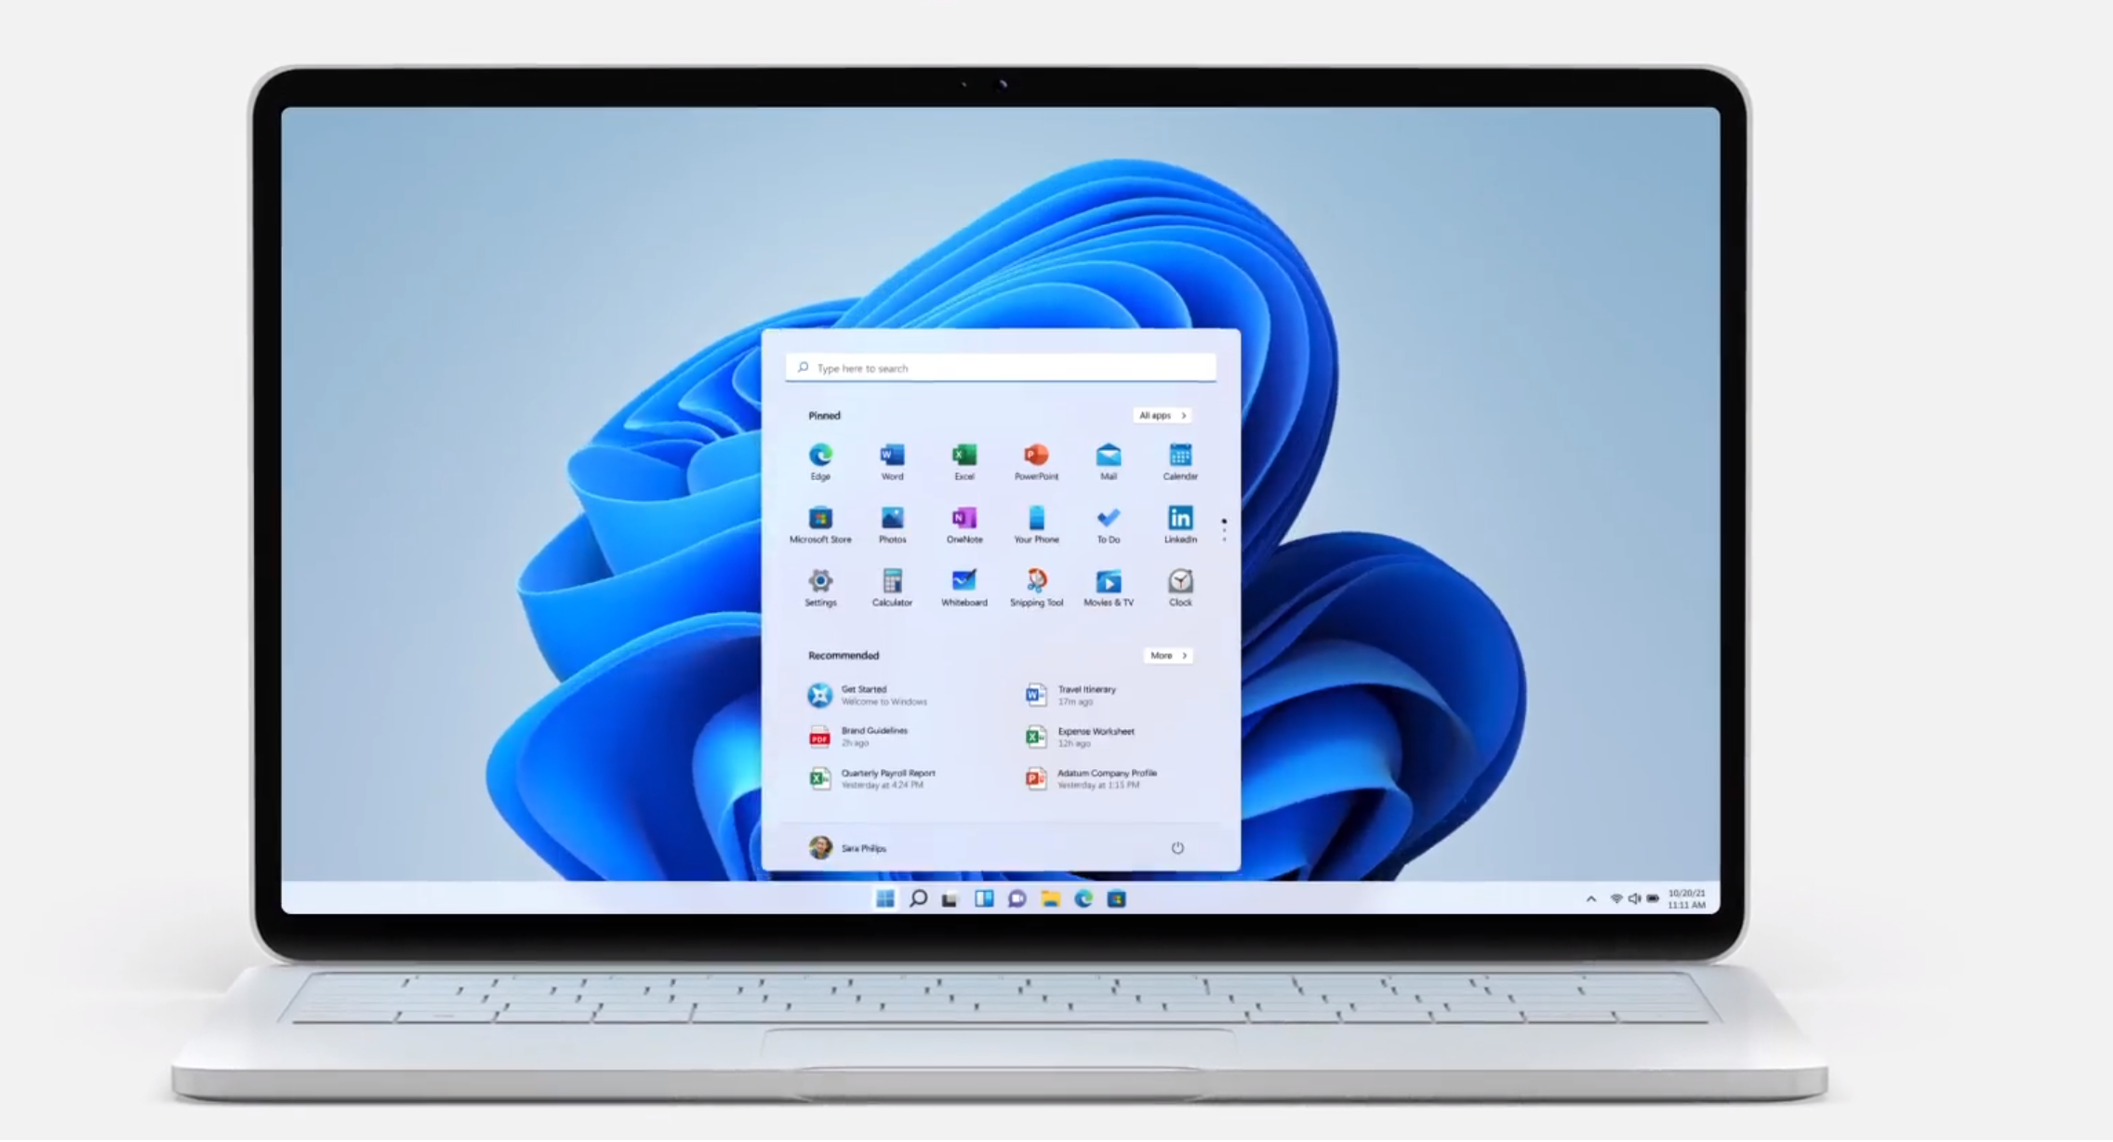
Windows 11

Slide 6
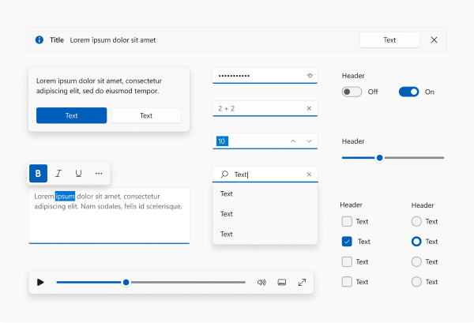
Windows 11 Controls

Slide 7
Windows App SDK
WinUI 3
Decouples Windows API implementation from the OS
Provided via NuGet package
Unified access to Windows APIs for both Windows 11 and 10
Supports .NET 5+

Slide 8
Windows App SDK 1.0 Preview 3
Windows 11 styled controls
Unpackaged apps (x64/x86)

Slide 9
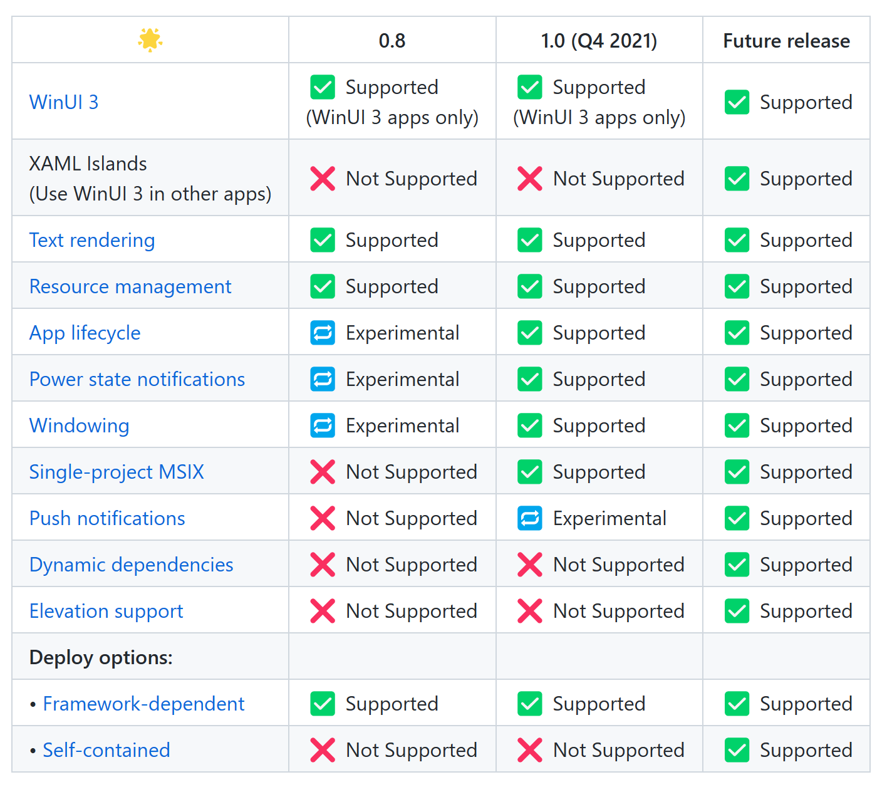
Packaged Apps

Slide 10
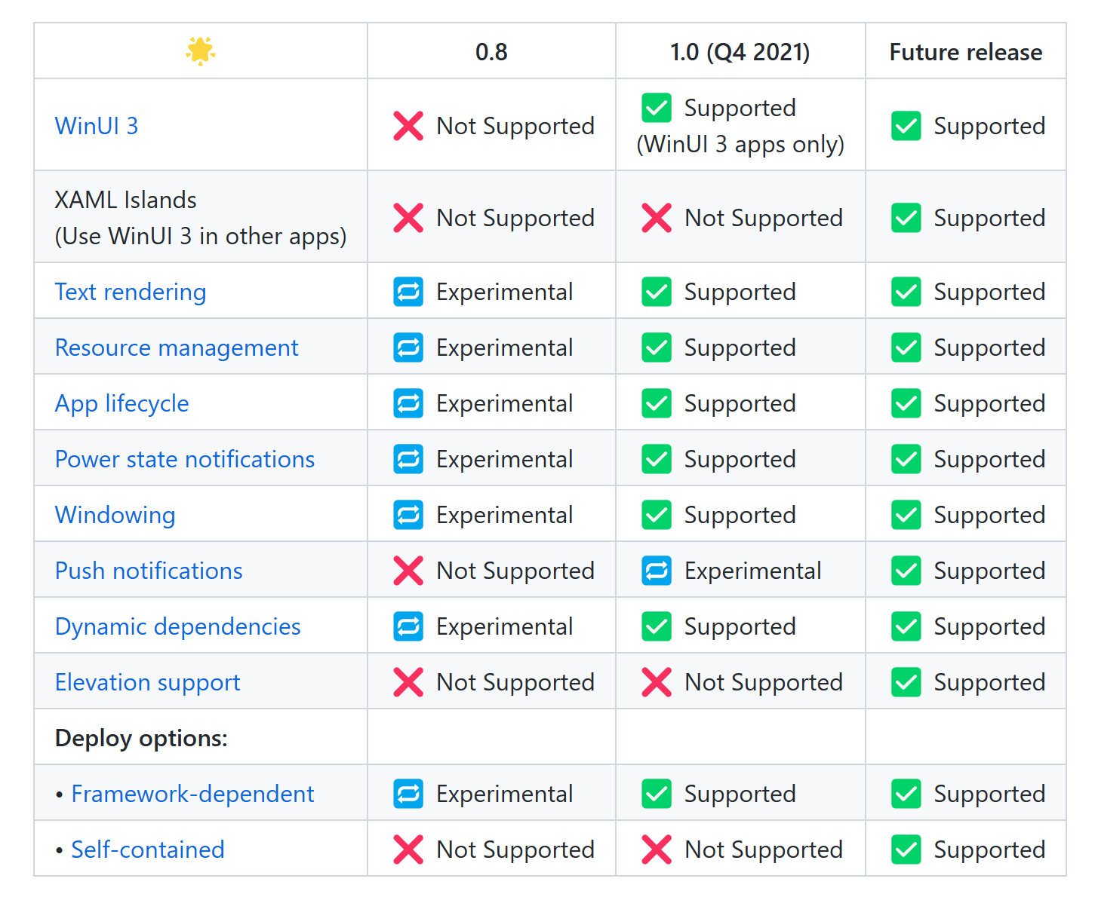
Unpackaged Apps

Slide 11
Demo
Building and Debugging Windows App SDK ARM64 Application

Slide 12
Current Challenges
Lack of Native IDE
Testing requires your own ARM device (for now)
Cross-compilation speed

Slide 13
Call to Action
File issues / feedback
Engage in different communities
Port your applications

Slide 14
Resources
Windows App SDK GitHub https://github.com/microsoft/WindowsAppSDK
Windows App SDK Docs https://docs.microsoft.com/en-us/windows/apps/windows-app-sdk/
Learn WinUI 3.0 – Alvin Ashcraft https://www.amazon.com/Learn-WinUI-3-0-application-development/
Surface Pro X Reddit Community https://reddit.com/r/surfaceprox
GitHub https://github.com/snickler

Slide 15

Thanks for joining!

